Slide 1
Spring Open Feign
Microservice Communication

Slide 3
Objective
By the end of this 45 minute session you will be able to communicate between two microservices with Feign.

Slide 4
Needs / Benefits
Simplifies REST calls between services

Slide 5
Environment Setup

Slide 6
Git clone https://github.com/Cognizant-FSE/petclinic-phase6
Launch all microservices, starting with owner
Run Rest-client last, which populates database

Slide 7
In Microservices Architecture:
Each microservice is bound to their own SQL instances
The entity tables don’t live in the same place
JPA cannot pull in related entities and deliver all the data
REST calls must be made between Microservices to obtain and update this data

Slide 8
Scenario
The current Pet microservice database only stores the owner Id. A UI component requires the pet info along with it’s owner’s full details. Let’s update the getPetById endpoint to return the owner details as well.

Slide 9
The Verbose Way

Slide 10
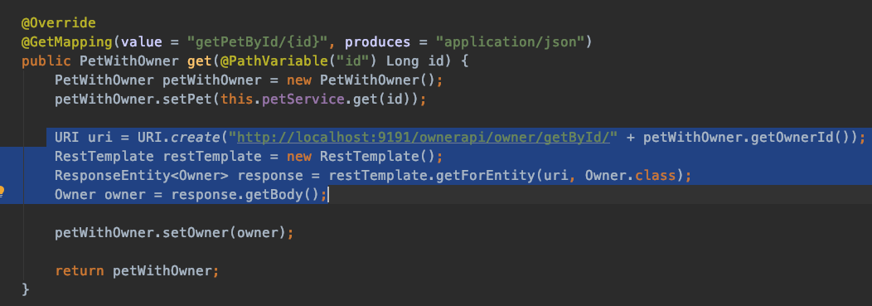
The Verbose Way
Using RestTemplate

Slide 11
Using Open Feign

Slide 12
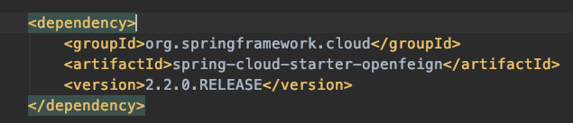
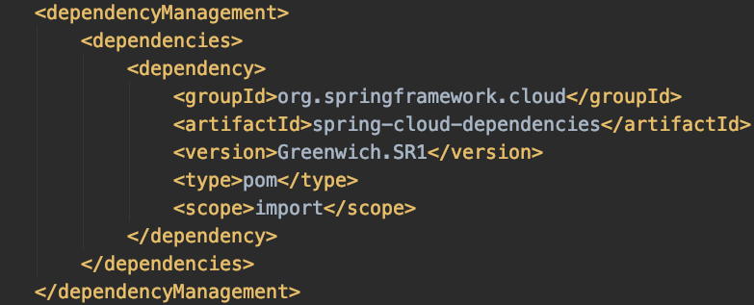
1. Add Dependency to Pom
Spring Version May Vary

Slide 13
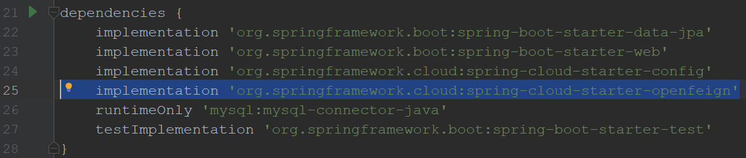
Or Using Gradle
org.springframework.cloud:spring-cloud-starter-openfeign

Slide 14
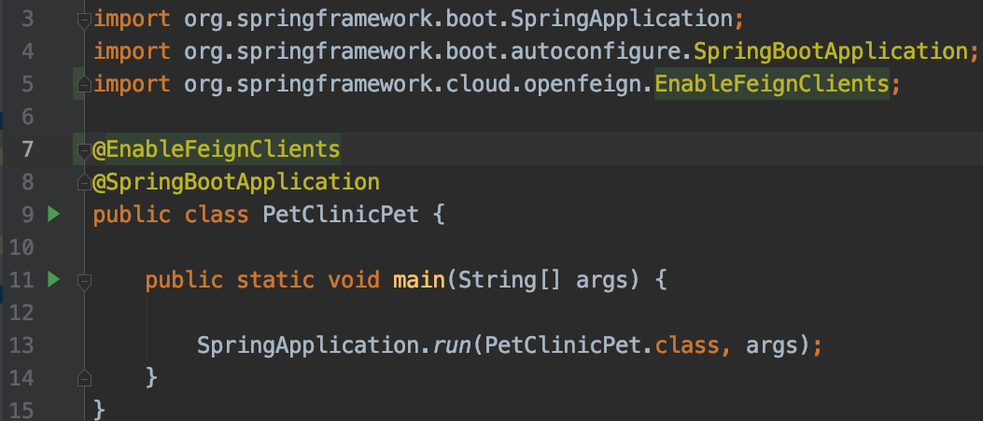
2. Add @EnableFeignClients to Application Class

Slide 15
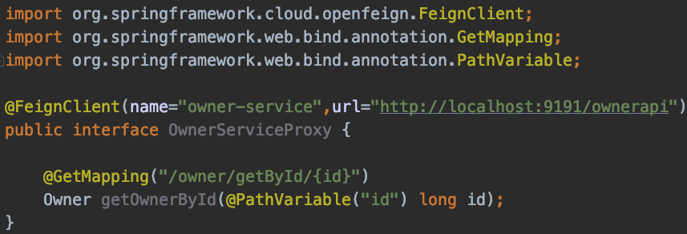
3. Create an Interface to serve as Proxy
Annotation
App name and url of service to be consumed
Signature matches controller method signature from service to be consumed
@PathVariable MUST be passed the variable name (as of
Notes:
The interface needs to be annotated with @FeignClient passing in the spring.application.name of the service to be consumed as well as its url. Oddly, feign client path variables must be passed the name of the variable.

Slide 16
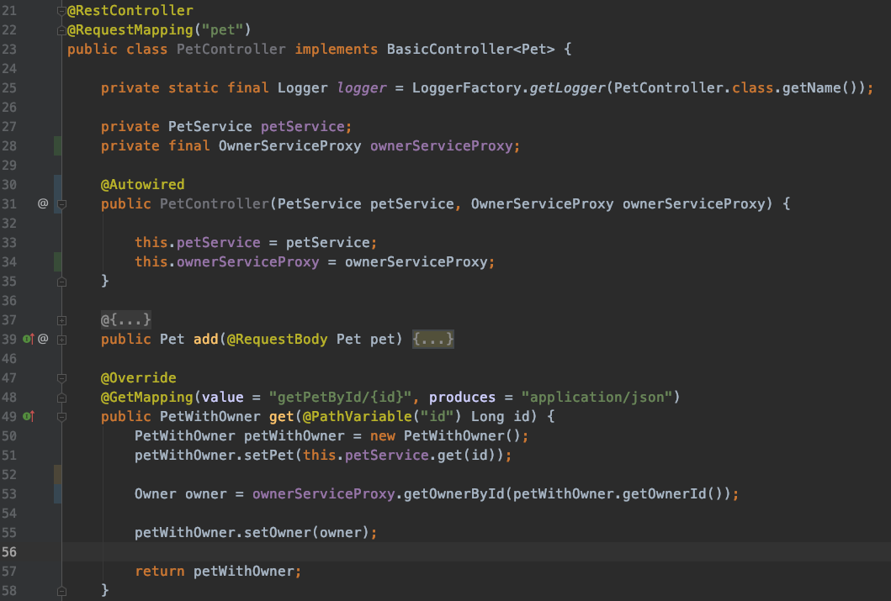
4. Inject and use as regular Bean
Inject
use
Notes:
Old style of injecting being used for testing sake, so that the beans can be mocked

Slide 17
Review
Open Feign Dependency
@EnableFeignClients
@FeignClient

Slide 18
Objective
By the end of this 45 minute session you will be able to write simple to complex queries on a NoSQL document data store.

Slide 19
What is the main purpose of Open Feign?
What are the main annotations used in Open Feign?
Notes:
Walk around and see how they are doing

Slide 20
Thank you
Jason Monroe (688776)

